Slide 1

Sporty Arena Booking app
Girish R Krishnan

Slide 2
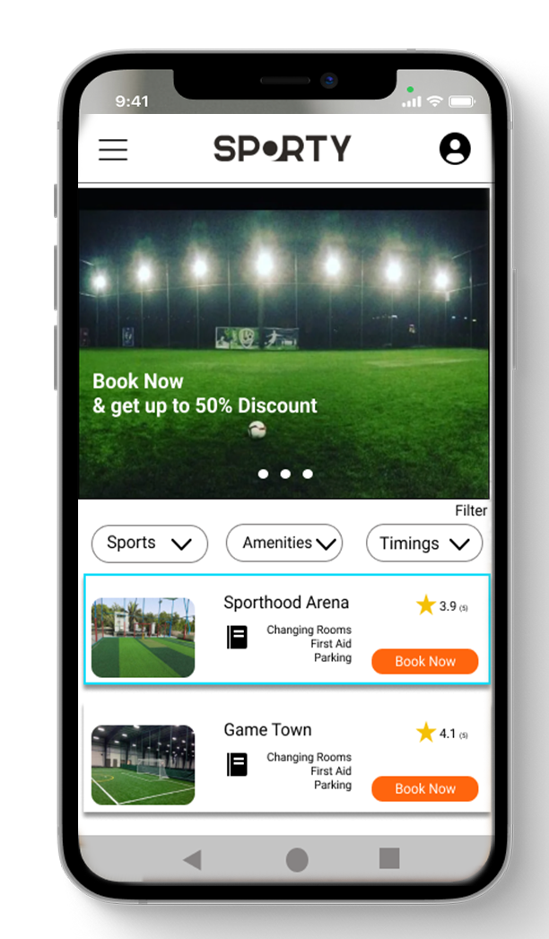
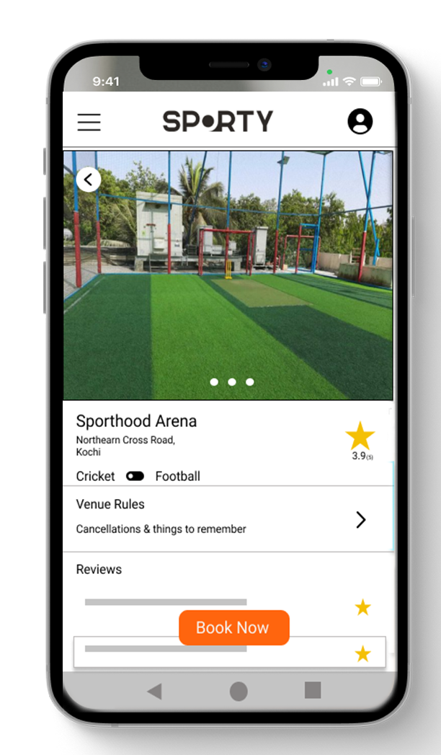
Project overview
The product:
Sporty Arena Booking App is a digital platform bringing together young athletes and coaches/academies online for an exceptional performance off-line.
Project duration:
IDec 2021 - March 2022

Slide 3
Project overview
The problem:
There was no one-stop shop for sports players looking to find, contact and book local sports turfs.
The goal:
ITo set about researching, getting support for and then building a platform that showed all sports venues anywhere in south India, and that was free and easy for anyone to use.

Slide 4
Project overview
My role:
UX designer designing an app for Sporty Arena Booking App..
Responsibilities:
Conducting interviews, paper and digital wireframing, low and high-fidelity prototyping, conducting usability studies, accounting for accessibility, and iterating on designs.

Slide 5
User research
Personas
Problem statements
User journey maps
Understanding
the user

Slide 6
User research: summary
I conducted interviews and created empathy maps to understand the users I’m designing for and their needs. A primary user group identified through research was working adults who find difficult to find an arena/ players
This user group confirmed initial assumptions about Sporty customers, but research also revealed that time was not the only factor limiting users from finding a turf. Other user problems included obligations, interests, or challenges that make it difficult to get to each turf and check its free time and also finding a partner..

Slide 7
User research: pain points
1
2
3
Time
Finding Parter
Finding Free Turfs
Working adults are too busy to spend time on finding turf
Some User find it difficult to find a partner for playing their Sport
For users it is difficult to go to every turf in the town and book a free slot

Slide 8
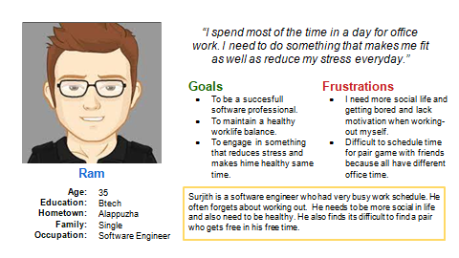
Persona: Name
Problem statement:
Ram is a busy working adult who needs to engage in something that reduces stress and makes him healthy same time.

Slide 9
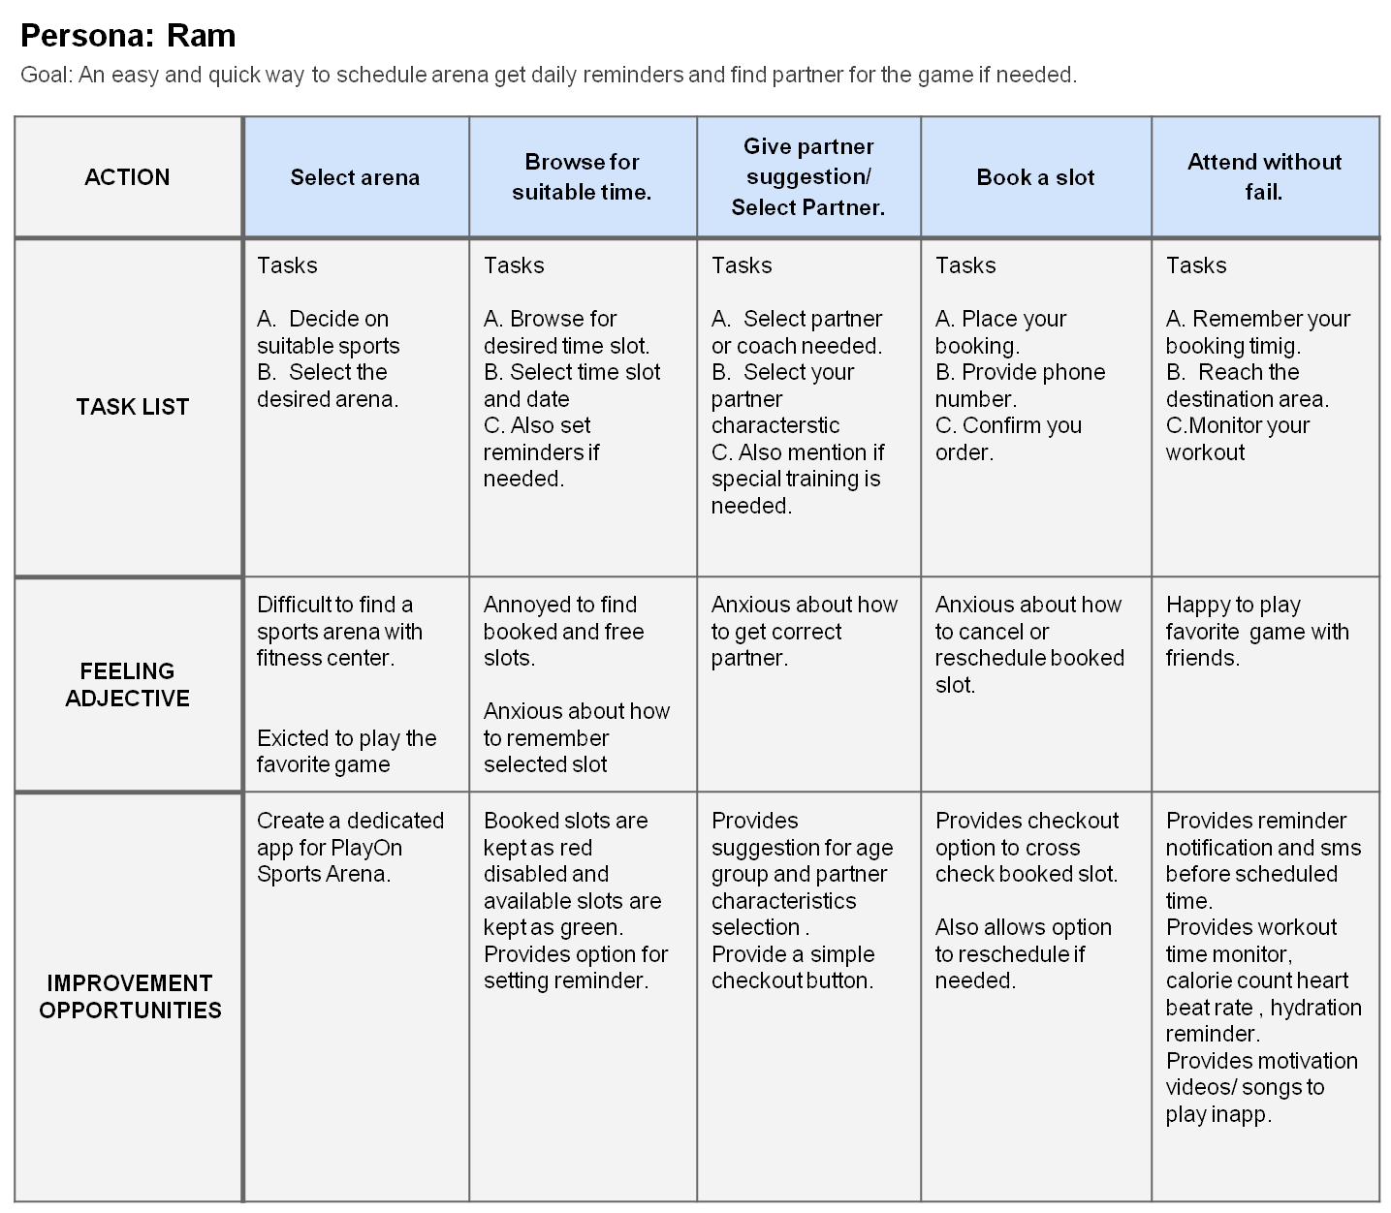
User journey map
Mapping Ram’s user journey revealed how helpful it would be for users to have access to a dedicated arena booking app.

Slide 10
Paper wireframes
Digital wireframes
Low-fidelity prototype
Usability studies
Starting
the design

Slide 11
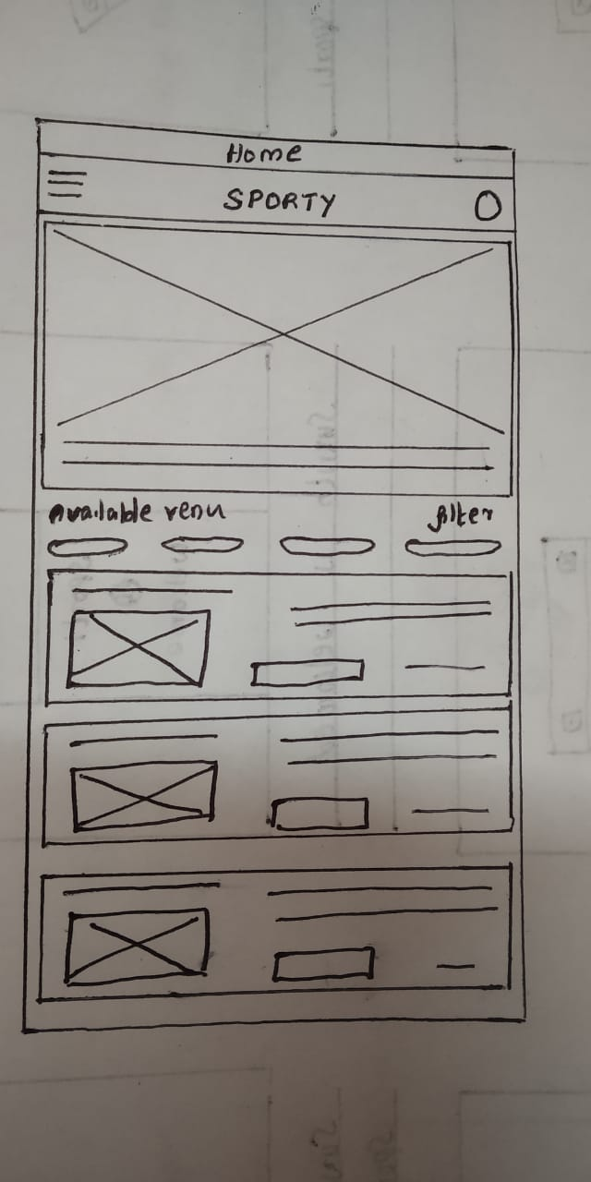
Paper wireframes
Taking the time to draft iterations of each screen of the app on paper ensured that the elements that made it to digital wireframes would be well-suited to address user pain points. For the home screen, I prioritized a quick and easy ordering process to help users save time.
Image of paper wireframes including five different versions of the same screen and one image of the new, refined version

Slide 12
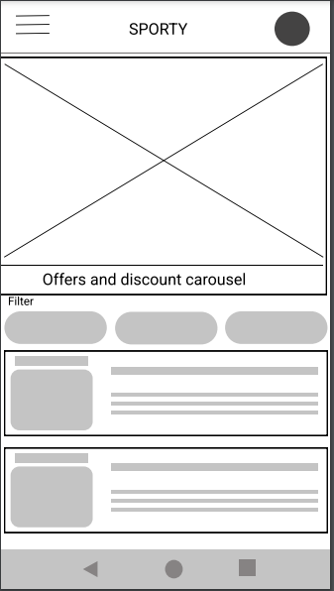
Digital wireframes
As the initial design phase continued, I made sure to base screen designs on feedback and findings from the user research.
Filters will enable users t0o select sports and amenities easier.
Each Arena/Turf will be shown with user rating will help user to choose one.

Slide 13
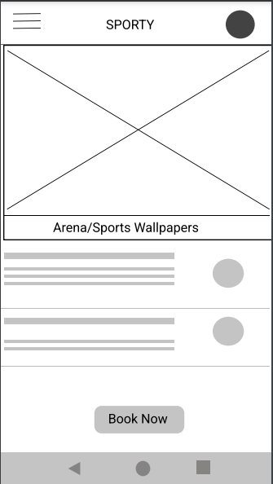
Digital wireframes
Easy navigation was a key user need to address in the designs in addition to equipping the app to work with assistive technologies.
User can see the arena photos and amenities in this screen
User can directly move to time slot selection

Slide 14
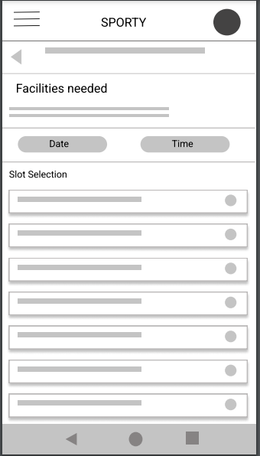
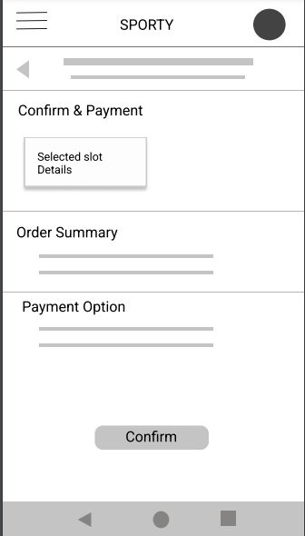
Low-fidelity prototype
Using the completed set of digital wireframes, I created a low-fidelity prototype. The primary user flow I connected was booking a arena, so the prototype could be used in a usability study.

Slide 15
Usability study: findings
I conducted two rounds of usability studies. Findings from the first study helped guide the designs from wireframes to mockups. The second study used a high-fidelity prototype and revealed what aspects of the mockups needed refining.
Round 1 findings
Round 2 findings
1
Users want to book arena quickly
1
Users want more payment options
2
Users want more customization options
2
Sign up need more options

Slide 16
Refining
the design
Mockups
High-fidelity prototype
Accessibility

Slide 17
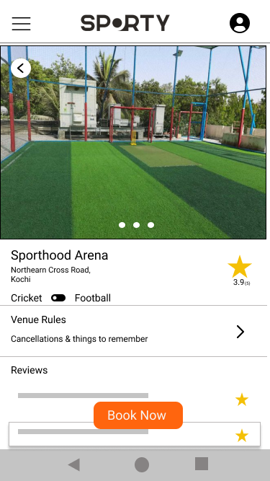
Mockups
Before usability study
After usability study
Early designs allowed for some customization, but after the usability studies, I added additional options to choose sports and choose amenities. I also revised the design so users see all the customization options when they first land on the screen.
Image of selected screen before usability study
Image of selected screen after usability study

Slide 18
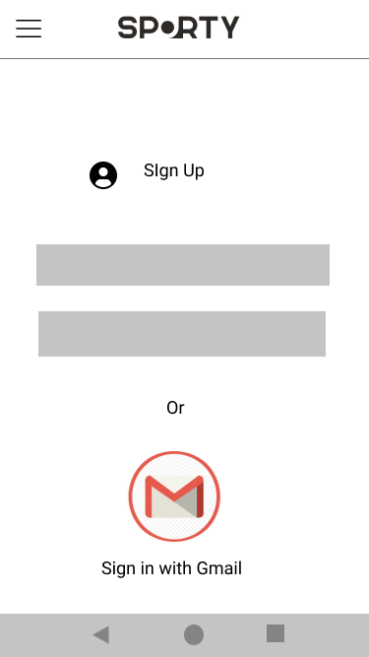
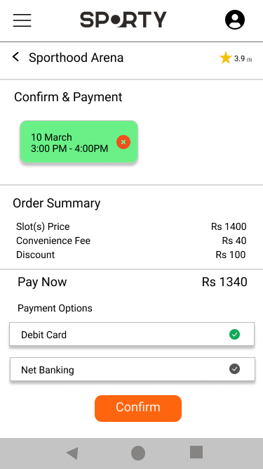
Mockups
Before usability study
After usability study
The second usability study revealed more options to sign up and payment,
I added the signup with gmail and more payments to this screen.
Image of selected screen before usability study
Image of selected screen after usability study

Slide 19
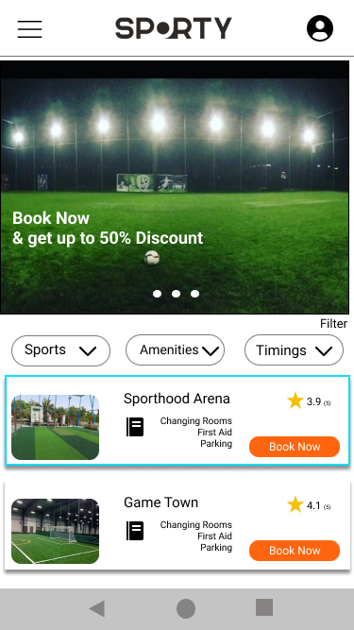
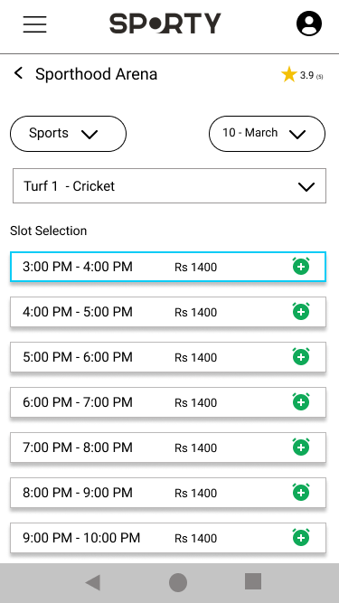
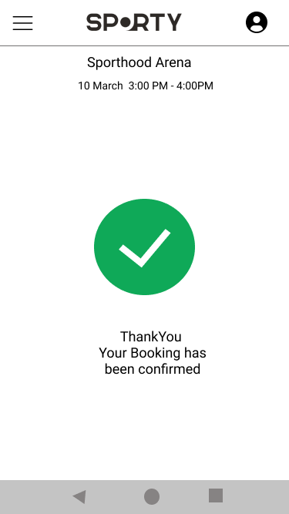
Mockups
Main mockup screen for display

Slide 20
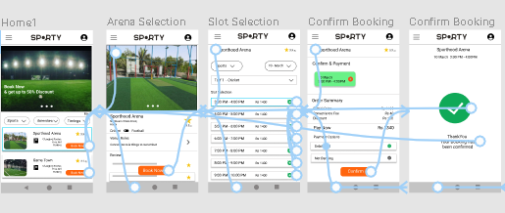
High-fidelity prototype
The final high-fidelity prototype presented cleaner user flows for booking an arena.
View the Sporty Arena Booking App high-fidelity prototype
Screenshot of prototype with connections or prototype GIF

Slide 21
Accessibility considerations
1
2
3
Provided access to users who are vision impaired through adding alt text to images for screen readers.
Used icons to help make navigation easier.
Used detailed imagery for arenas and icons help all users better understand the designs.

Slide 22
Going forward
Takeaways
Next steps

Slide 23
Takeaways
Impact:
The app makes users feel like Sporty Arena Booking App really thinks about how to meet their needs.
One quote from peer feedback:
“The app made it so easy and fun to book and select turfs I would definitely use this app ”
What I learned:
While designing the Sporty Arena Booking App, I learned that the first ideas for the app are only the beginning of the process. Usability studies and peer feedback influenced each iteration of the app’s designs.

Slide 24
Next steps
1
2
Conduct another round of usability studies to validate whether the pain points users experienced have been effectively addressed.
Conduct more user research to determine any new areas of need.

Slide 25
Insert a few sentences summarizing the next steps you would take with this project and why. Feel free to organize next steps in a bullet point list.
Let’s connect!
Thank you for your time reviewing my work on the Sporty Arena Booking App. If you’d like to see more or get in touch, my contact information is provided below.
Email: mailtogirishkrishna@gmail.com
Website: https://girishrkrishnan.github.io/

